Slide 1
11.09.2012
English Arts
Lesson 1
Vocabulary
Cougars Win, Eggs Lose

Slide 2
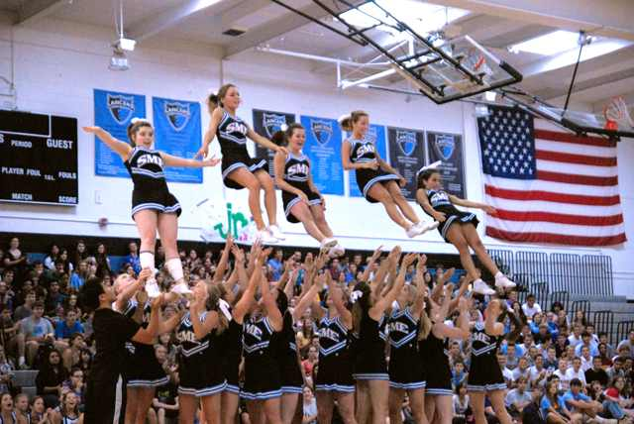
Ricocheted

Slide 3
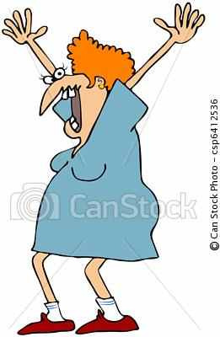
Hysterical

Slide 4
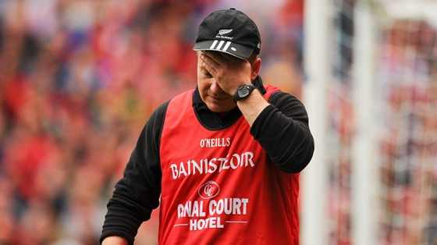
Crestfallen

Slide 5
Ecstatic

Slide 6
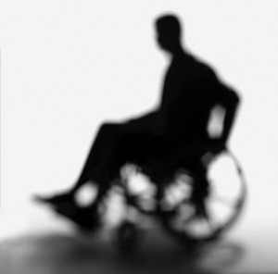
Incapacitated

Slide 7
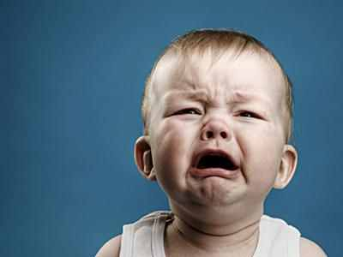
Lamented

Slide 8
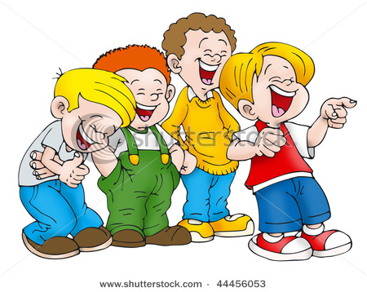
Mirth
LOL

Slide 9
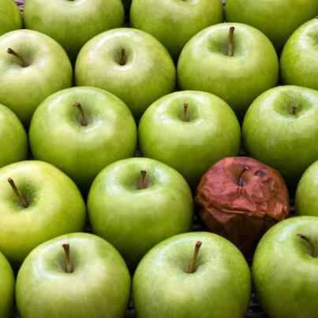
Perishable

