Slide 1
Lesson 2 Vocabulary
23rd of September 2012
Whale Watching

Slide 2
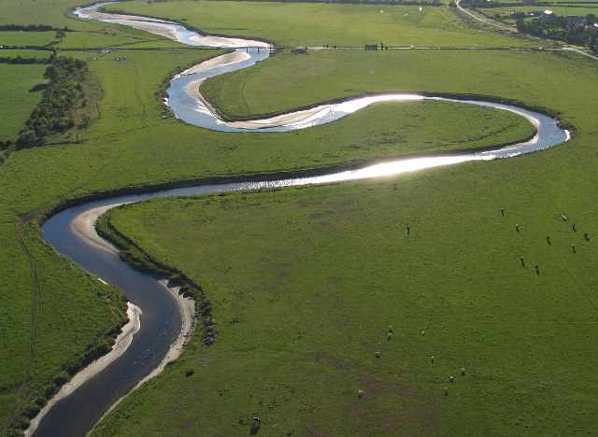
Meandering

Slide 3
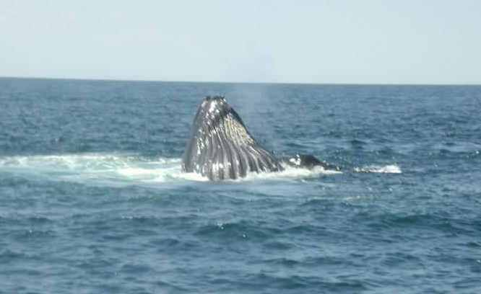
Emerged

Slide 4
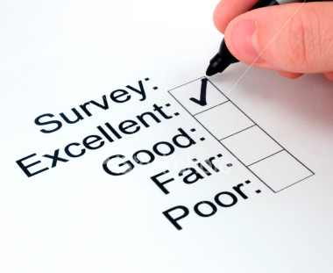
Survey

Slide 5
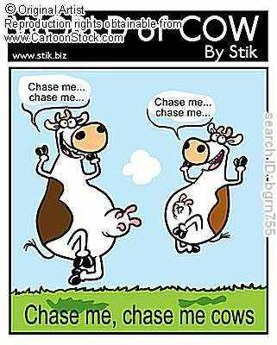
Frolicked

Slide 6
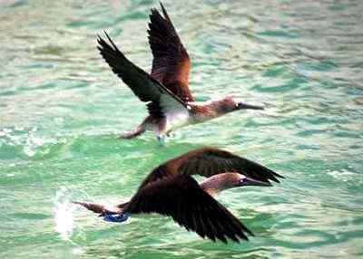
Hovered

Slide 7
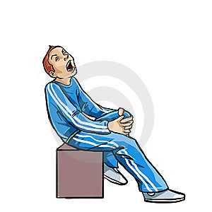
Tormented

Slide 8
Inquire

Slide 9
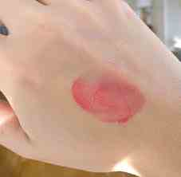
Subtle

